Slide 1
Recitation 2: Bitwise Operators and I/O
CS 0449: Introduction to Systems Software
Griffin Hurt
Griffin Hurt
Undergraduate Teaching Fellow
griffhurt@pitt.edu
https://griffinhurt.com
Spring 2024, Term 2244
Friday 2 PM Recitation
Jan 26th, 2024
Slides adapted from
Shinwoo Kim, Martha Dixon, and Vinicius Petrucci
Department of Computer Science
School of Computing & Information
University of Pittsburgh
Bitwise operators
Input and Output in C
Lab 1: Data Lab

Slide 2
Agenda
Course News!
Review of Bitwise Operations
C Programming: Basic I/O
Using scanf() and printf()
Lab 1 - Data Lab

Slide 3
Course News
Updated TA Office Hours:
Materials are on my website: https://griffinhurt.com/teaching/
Lab 1 announced
Due: 5:59PM Thursday, February 1st, 2024.
Day | Time/Location
Monday | 1:00PM – 2:30PM @ 130 N Bellefield, 5th Floor or Zoom
Tuesday | 11:00 AM - 2:00 PM @ 130 N Bellefield, 5th Floor or Zoom
Thursday | 4:00 PM – 5:30 PM @ Zoom only
By appointment | Message me to schedule a meeting (in-person/virtual)

Slide 4
Bitwise Operations
With materials from Jarrett Billingsley

Slide 5
Bitwise AND ("Logical product")
AND takes two bits and gives you one new one.
it can be written a number of ways:
A&B A ∧ B A ⋅ B AB
if we use the and instruction (or & in C/Java):
A | B | Y
0 | 0 | 0
0 | 1 | 0
1 | 0 | 0
1 | 1 | 1
 | 1 | 1 | 1 | 1 | 0 | 0 | 0 | 0
& | 0 | 0 | 1 | 1 | 1 | 0 | 1 | 0
= | 0 | 0 | 1 | 1 | 0 | 0 | 0 | 0
we did several independent AND operations.

Slide 6
Bitwise OR ("Logical sum")
we might say "and/or" in English
it can be written a number of ways:
A|B A∨B A+B
if we use the or instruction (or | in C/Java):
A | B | Y
0 | 0 | 0
0 | 1 | 1
1 | 0 | 1
1 | 1 | 1
 | 1 | 1 | 1 | 1 | 0 | 0 | 0 | 0
| | 0 | 0 | 1 | 1 | 1 | 0 | 1 | 0
= | 1 | 1 | 1 | 1 | 1 | 0 | 1 | 0
we did several independent OR operations.

Slide 7
Bitwise NOT
the ~ instruction
A | Y
1 | 0
0 | 1
~ | 1 | 1 | 1 | 1 | 0 | 0 | 0 | 0
= | 0 | 0 | 0 | 0 | 1 | 1 | 1 | 1
we did several independent NOT operations.

Slide 8
Bit shifting
besides AND, OR, and NOT, we can move bits around, too.
1 1 0 0 1 1 1 1
if we shift these bits left by 1…
1 1 0 0 1 1 1 1 0
we stick a 0 at the bottom
1 1 0 0 1 1 1 1 0 0
again!
1 1 0 0 1 1 1 1 0 0 0
AGAIN!
1 1 0 0 1 1 1 1 0 0 0 0
AGAIN!!!!

Slide 9
Left-shifting in C
C/Java/Python/etc. use the << operator for left shift
B = A << 4; // B = A shifted left 4 bits
but wait, If the bottom 4 bits of the result are now 0s…
…what happened to the top 4 bits?
0011
0000
0000 0000 1111 1100 1101 1100 1111
0000 0000 1111 1100 1101 1100 1111
bits that get "shifted off" the top are discarded. this may or may not lead to problems!
Bit Bucket

Slide 10
So… what does it DO?
let's start with a value like 5 and shift left and see what happens
Binary | Decimal
00000101 | 5
00001010
10
00010100
20
00101000
40
01010000
80

Slide 11
a << n == a × 2n
shifting left by n is the same as multiplying by 2^{n}
you probably learned this as "moving the decimal point"
and moving the decimal point right is like shifting the digits left
with bit shifting, we're moving the binary point (yes, really)
shifting is fast and easy on most CPUs
way faster than multiplication in any case
HLL compilers will try really hard to replace "multiplication by a constant" with shifts and adds

Slide 12
<_< >_>
we can shift right, too
0 0 1 1 0 0 0 0 0 0 0 0 1 1 1 1 1 1 0 0 1 1 0 1 1 1 0 0 1 1 1 1
0 0 0 1 1 0 0 0 0 0 0 0 0 1 1 1 1 1 1 0 0 1 1 0 1 1 1 0 0 1 1 1
0 0 0 0 1 1 0 0 0 0 0 0 0 0 1 1 1 1 1 1 0 0 1 1 0 1 1 1 0 0 1 1
0 0 0 0 0 1 1 0 0 0 0 0 0 0 0 1 1 1 1 1 1 0 0 1 1 0 1 1 1 0 0 1
0 0 0 0 0 0 1 1 0 0 0 0 0 0 0 0 1 1 1 1 1 1 0 0 1 1 0 1 1 1 0 0

Slide 13
a >>> n == a ÷ 2n
shifting right by n is the same as dividing by 2^{n}
Binary | Decimal
that's what integer division gives us too, right?
01010000
80
00101000
40
5 / 2 == 2
00010100
20
00001010
10
but soon we'll see that right-shifting and division can sometimes disagree.
00000101
5
00000010
2

Slide 14
Signed numbers messing things up again
Unsigned
Signed
1 0 1 0 1 1 0 0
= 172
= -84
0 1 0 1 0 1 1 0
= 86
= 86
well that's a little unfortunate.
0 0 1 0 1 0 1 1
= 43
= 43
Arithmetic Right Shift is used for signed numbers: it "smears" the sign bit into the top bits.
1 0 1 0 1 1 0 0
= -84
1 1 0 1 0 1 1 0
= -42
1 1 1 0 1 0 1 1
= -21
C uses >> (depends on data type)

Slide 15
Uh oh, they're fighting
n
Binary
Decimal
a÷2^{n}
0
10110000
-80
-80
well that's a little weird.
1
11011000
-40
-40
2
11101100
-20
-20
actually, this is correct. but so is the way that integer division works. they're both right.
3
11110110
-10
-10
4
11111011
-5
-5
5
11111101
-3
-2
6
11111110
-2
-1
(we'll come back to this.)
7
11111111
-1
0

Slide 16
Doing modulo with bitwise AND
in decimal, dividing by powers of 10 is trivial.
53884 ÷ 1000 = 53 R 884
53884 ÷ 1000 = 53 R 884
in binary, we can divide by powers of 2 easily with shifting…
and we can get the modulo by powers of 2 with bitwise AND!
10010110 ÷ 1000 = 10010 R 110
10010110 ÷ 1000 = 10010 R 110
10010110
>>> 3
00010010
10010110
& 00000111
00000110
so, a % 2^{n} == a & (2^{n}-1)

Slide 17
Bitwise != Logical
! is a boolean operator, so it changes the logic value of the expression.
E.g., !1 == 0 (b/c !true == false)
In C, booleans are just ints
false == 0
true != 0
Caveat: C only guarantees that true is a non-zero integer.
Practically, many systems/libraries define true to be 1
!42== 0
~ is a bitwise operator, it affects the values of individual bits:
E.g. (with 8 bits)
~0 → -1 (00000000 → 11111111)
~5 → -6 (00000101 → 11111010)

Slide 18
Quiz Time! (Don’t worry, it’s for completion) The access code is:_______

Slide 19
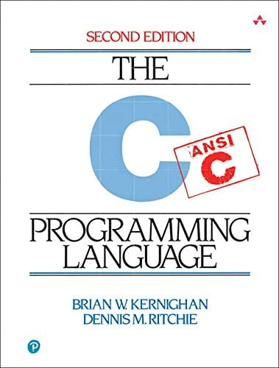
C Programming
Basic Input/Output using the C Standard Library

Slide 20
Standard C Library (libc)
In Lab0, you used printf() in the Hello World program
> printf("Hello world! x is currently %d \n", x);
> Hello world! x is currently 2
printf() stringified the arguments and printed to the standard output
formatted the string and filled-in the placeholders (e.g., %d)
Notice we didn’t need to implement that printf() function ourself
printf() is a function built-in to C’s standard I/O library
Hence, we needed to tell our compiler to make use of the standard library functions with #include <stdio.h>
You will soon talk about how the libraries are linked to your code in lecture

Slide 21
man gives us information about functions, commands, libraries
On most Unix/Unix-like systems, you can use man to learn more about functions/commands/etc.
The manual has the most accurate information about all the library functions, programs, commands, etc.
> Man printf
SCANF(3) Library Functions Manual SCANF(3)
NAME
printf, fprintf, ... , vsnprintf - formatted output conversion
...
DESCRIPTION
The functions in the printf() family produce output according to a format as described below
...
If you are having trouble running man on Thoth, google man printf

Slide 22
Detailed look at using printf()
int printf(const char * format, ...);
Returns an integer: number of characters printed (excluding null terminator)
Remember, in C, a string is just an array of characters
We place placeholders which begin with a percent sign (%). The variables which comes after the formatter will replace the placeholders when printing
#include <stdio.h>
int main()
{
printf("Name: %s, Info:\n", "John");
printf("\tAge: %d \t Ht: %f\n", 20, 5.9);
printf("\tYear: %d \t Dorm: %s\n", 3, "Towers");
return 0;
}
Name: John, Info:
Age: 20 Ht: 5.9
Year: 3 Dorm: Towers

Slide 23
Reading Input using scanf()
Like printf(), scanf() is another C standard library function
Used to read character, string, numeric data from keyboard
Again, if you want to use it in your program you have to include the header ( #include <stdio.h>)
int scanf(const char * format, ...)
Returns an integer: number of input items successfully matched and assigned
Defines what we are reading (character? Integer? Float?)
Passes by reference (a pointer) to the variable which will hold our input

Slide 24
Example code using scanf() _{(live demo)}
#include <stdio.h>
int main()
{
char ch;
int x;
printf("Enter any character \n");
scanf("%c", &ch);
printf("Entered character is %c \n", ch);
printf("Enter any integer\n");
scanf("%d", &x);
printf("Entered integer is %d\n", x);
return 0;
}

Slide 25
Lab 1: Data Lab
Practicing with data and input

Slide 26
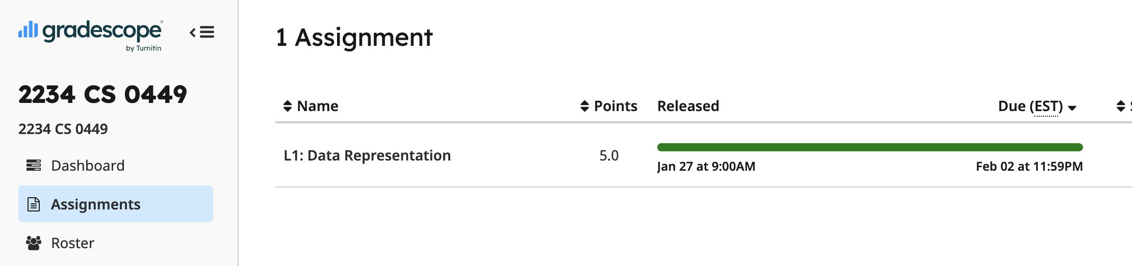
Part A: Practicing Data and Bitwise Manipulation
Collaboration: You are encouraged to work with one other person.
Select your partner’s name on Gradescope
Part A – Problems
See L1: Data Representation on Gradescope
Multiple choice, fill-in-the-blank type of questions

Slide 27
Part A: Understanding sizeof()
To help you complete the questions on Gradescope…
You can a file size.c and write code to calculate size of each value
Expected output:
The size of <some value> is #
The size of <some other value> is #
The size of <a third value> is #
Hint: The special 'sizeof()' macro gives us the byte size.

Slide 28
B2: Understanding ternary operators
TODO: Implement the function ternary in ternary.c
int ternary(int cond, int true_value, int false_value) { /*...*/}
Cannot use the ternary operator
Output of ternary should be the same as: cond?true_value:false_value
VARIABLE = COND ? TRUE_VALUE : FALSE_VALUE
VARIABLE == ternary(COND, TRUE_VALUE, FALSE_VALUE)
The condition to be tested (returns true/false)`
The value to be returned if the condition is true
The value to be returned if the condition is false
In C, FALSE == 0; TRUE != 0 (usually TRUE == 1 but not always)

Slide 29
B3: Creating a simple calculator
Enter your calculation:
3 + 4
> 3 + 4 = 7
Enter your calculation:
3 c 4
Invalid calculation! "3 c 4"
Requirements
Create 1 files: calculator.c
Inputs must be read from keyboard (use scanf())
Support the following operations:
+, -, *, /, %(mod)
& (bitwise and), ~ (bitwise not)
Your output must match the sample output
User Input
HINT: Take a look at calculator.c from Lab0

